Slide 1
Daniel Martinez
Francisco Fierro
Kyle Pamintuan
Matthew Le

Slide 2
Intro
What is our application?
What it addresses?
Functionalities
Special Qualities
Notes:
Hi, i’m Matt. This is Kyle, Francisco, and Daniel. Today we’ll go over what our application is, what it addresses, its functionalities, and its special qualities.
So first of, has this happened to any of you?
You signed up for a class and then found that it has participation as part of the grade.
I’m not talking about a mere 1-2%, i’m talking about a full 10% participation.
Not the one where you just show up to class but the type of participation that requires you to raise your hand and answer questions.
Some people might find that fine, but the majority of people dread it.
Don’t you wish there was an easier way to participate in class?
Enter Speak Up

Slide 3

Speak Up
Chat Client for Web and Mobile app made specially for school
“chat room” specifically made for each of their classes
2 Different version
Student and Educator
Educator Version
Similar to student’s
Gives more power
Notes:
Speak Up is a chat client for Web and mobile application specially made for school.
Students are able to “participate” in these chatrooms, specifically made for each one of their classes.
They’re going to be two version.
1- Specially made for students
1- Specially made for Teachers
We’ll go over the differences in a bit.

Slide 4

What “Speak Up” Addresses?
Some reasons students might not participate in class because:
Introversion
Language differences
Don’t know answer
Lack of interest
Didn’t hear the statements
Allow students to participate anonymously
Notes:
Some reasons students don’t participate in class because they might be introverts, language differences, don’t know the answers, or wasn’t listening.
With Speak Up, it allow students to be anonymous when “participating in class”.
So you can answer the professor’s question without worrying about the consequences.
Next we’ll go over the functionalities Speak Up has to offer.

Slide 5
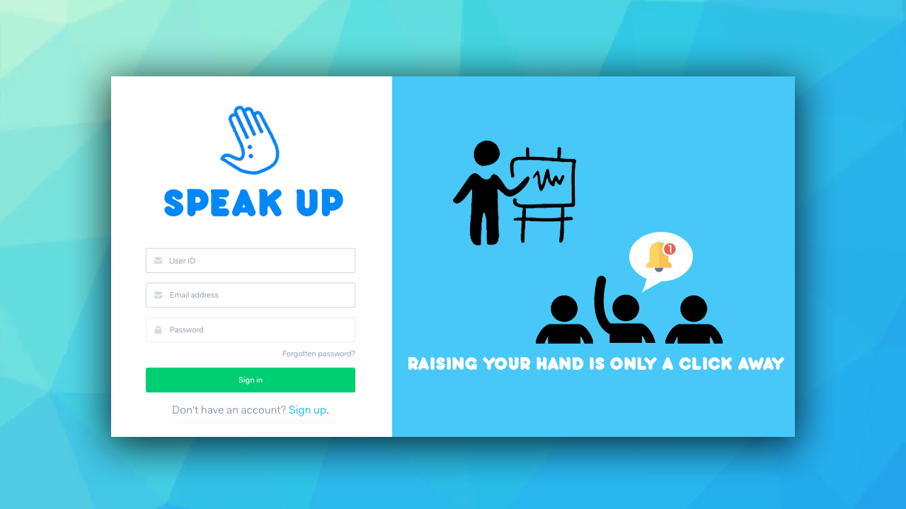
Functionalities
Login
Student/Teacher ID
Student/Teacher
Email
Password
2 Versions:
Student Version
Teacher Version

Slide 6
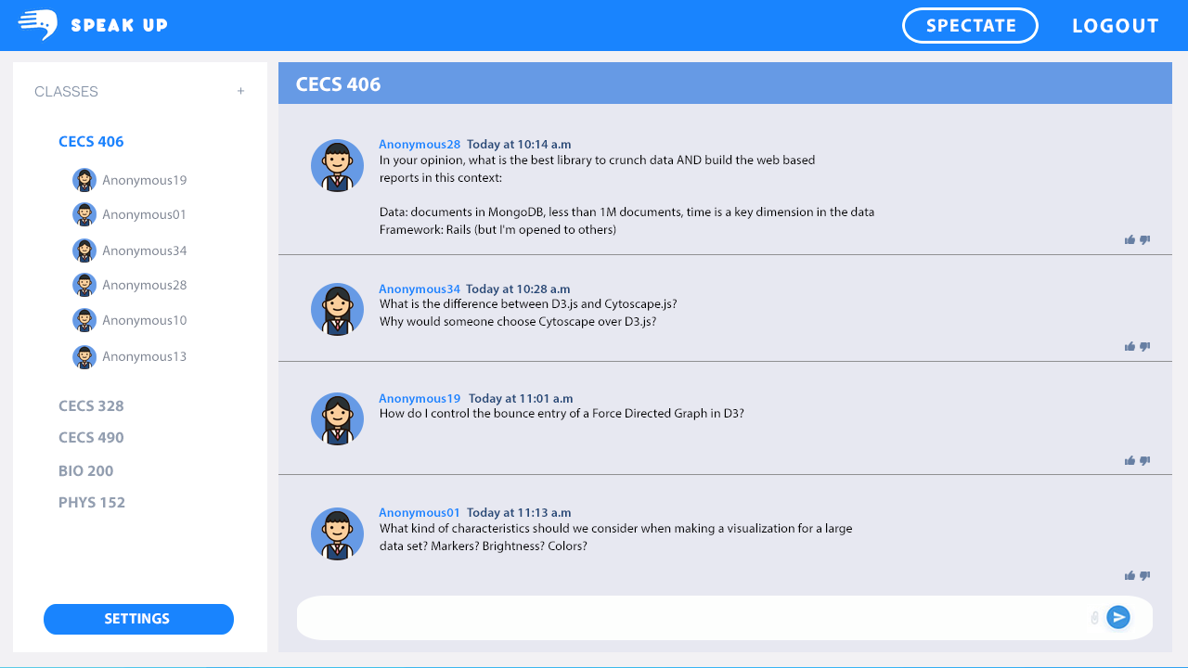
Student’s Version
Features:
Personal Class list
Anonymity in chatroom
Spectator mode
Settings
Reputation System
Access code for joining

Slide 7
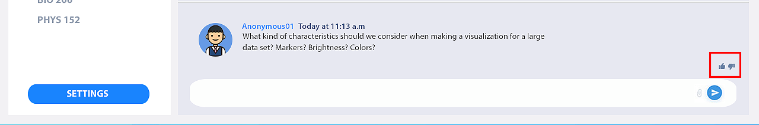
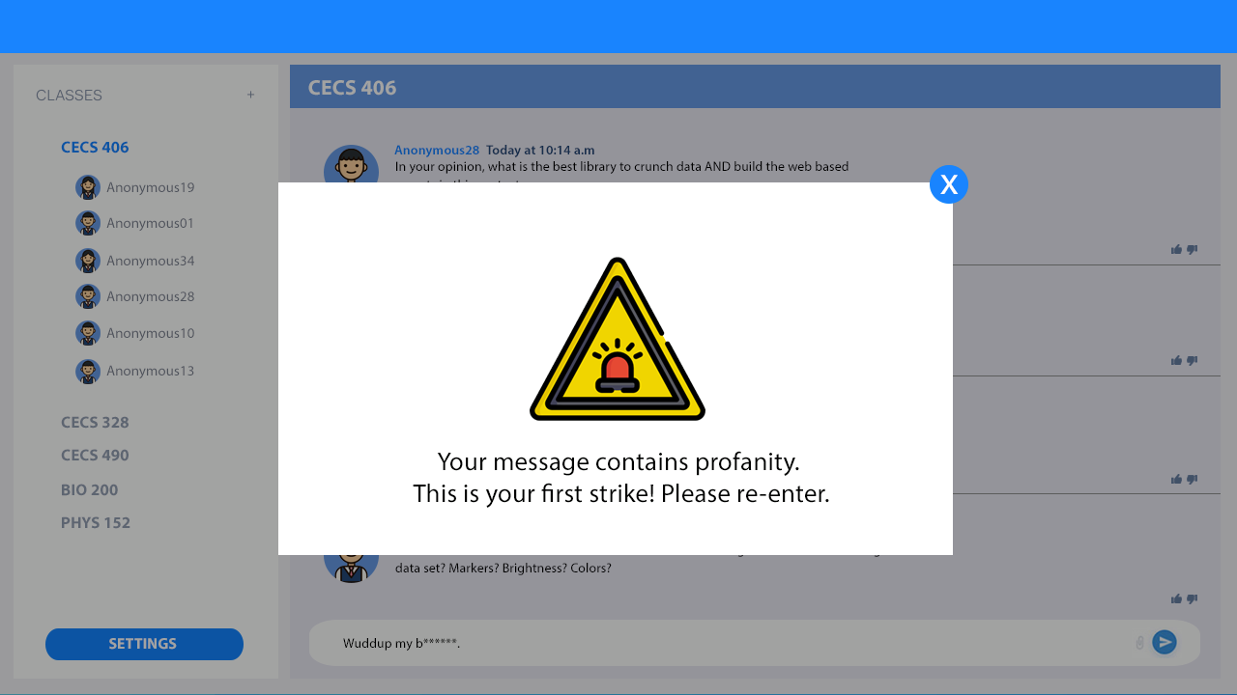
Student’s Version
Upvote/Downvote
Comment on other comments
Increase participation points
Profanity check
3 strikes
Get kicked

Slide 8
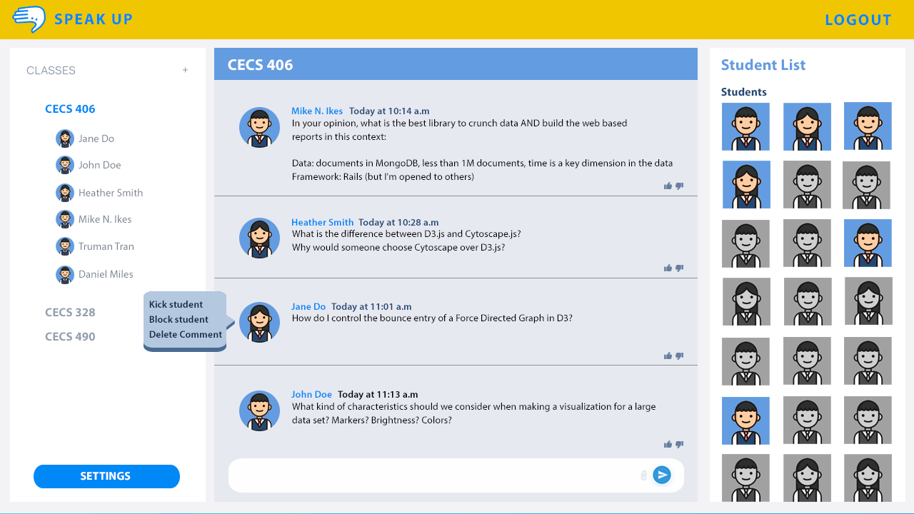
Educator’s Version
Students are not anonymous
Student list
absents
present
Ability to kick and block student
Ability to delete comments
Generate access codes for student

Slide 9
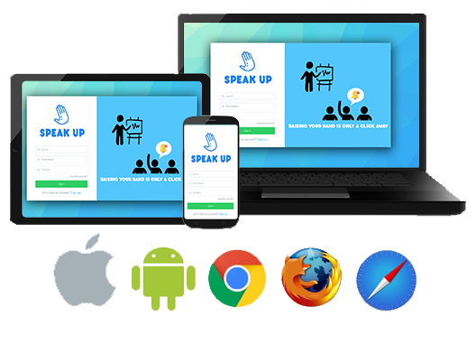
Special Qualities
Multi-Platform
Integrated Tools
-free to students
-charge only the school annually

Slide 10
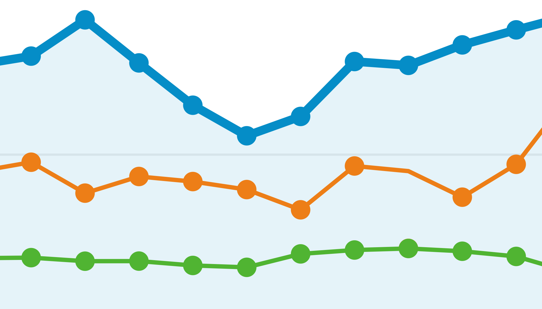
Special Qualities
Analytics for Instructors and Students
Participation
Polls
Grades

Slide 11
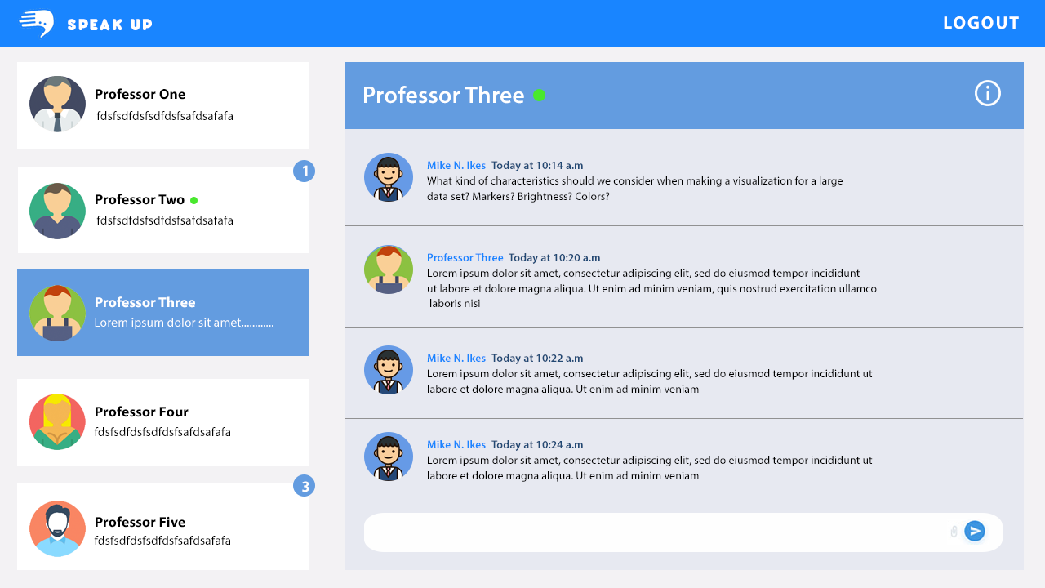
Direct messaging between instructor and students

Slide 12

Conclusion

